Slide 1

Complaint Management System: Building Customer Trust Through Effective Resolution
In today's competitive business landscape, customer satisfaction is paramount. A robust complaint management system is no longer a luxury but a necessity for any organization aiming to build trust, improve customer relationships, and drive sustainable growth. This presentation explores the key components and benefits of a comprehensive complaint management system, outlining how it can transform the way you address customer concerns and foster enduring loyalty.
D. SUSHMANTH
P. ARJUN

Slide 2

Importance of Effective Complaint Handling
1
Customer Retention
2
Brand Reputation
Unsolved complaints lead to customer churn, directly impacting revenue. Effective complaint handling demonstrates your commitment to customer satisfaction and builds trust, encouraging repeat business.
Negative online reviews and social media posts can quickly damage a brand's image. A system that addresses complaints promptly and effectively helps maintain a positive public perception.
3
Product Improvement
4
Employee Morale
Customer feedback through complaints provides valuable insights into product flaws or service shortcomings. Analyzing these insights allows you to enhance offerings and improve overall customer experience.
When employees are empowered to resolve complaints efficiently, it fosters a sense of ownership and pride in their work, leading to increased job satisfaction and reduced turnover.

Slide 3
Key Benefits of a Complaint Management System
Centralized Platform
Automated Processes
Data Analytics
A unified system streamlines complaint intake, tracks progress, and provides a comprehensive view of all customer feedback, ensuring efficient and consistent handling.
Automate repetitive tasks like complaint assignment, notification, and escalation, freeing up staff to focus on resolving complex issues and improving customer interactions.
Gather valuable insights into complaint trends, common issues, and customer demographics, enabling you to identify areas for improvement and implement proactive solutions.

Slide 4
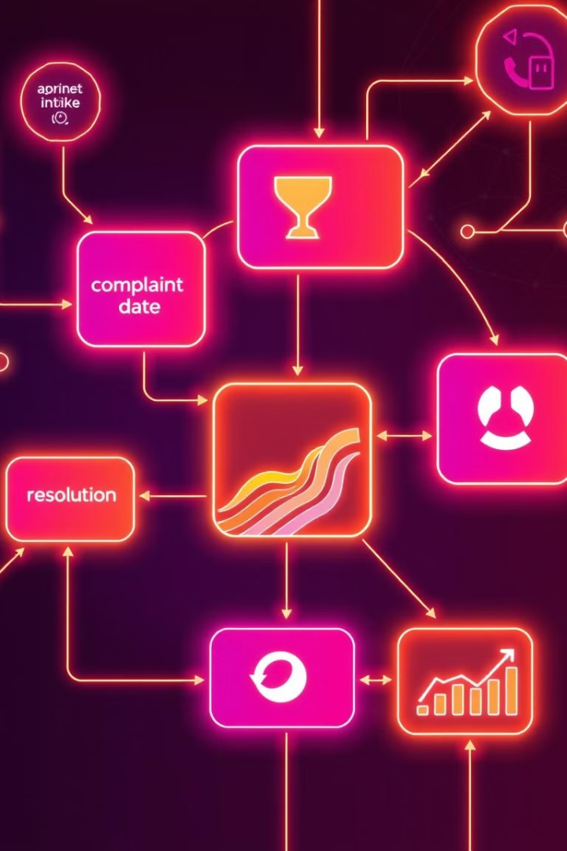
Core Components of a Complaint Management System
Complaint Intake
Complaint Routing
Easy-to-use channels for customers to submit complaints, including online forms, email, phone, and live chat, ensuring a smooth and accessible experience.
Efficiently assigns complaints to the appropriate team or individual based on the nature of the issue, ensuring prompt and relevant resolution.
Complaint Tracking
Resolution Management
Provides a centralized system to track the progress of each complaint, including timelines, status updates, and communication history, ensuring transparency and accountability.
Empowers employees with tools and resources to effectively address complaints, including predefined solutions, escalation processes, and knowledge bases.

Slide 5





Streamlining the Complaint Process
Intake
Routing
Resolution
Closure
Customers can submit complaints through various channels, such as online forms, email, or phone calls. The system automatically logs the complaint, captures relevant details, and assigns a unique identifier.
The system automatically routes the complaint to the appropriate team or individual based on the issue's nature, ensuring efficient and timely response.
Designated personnel address the complaint, investigate the issue, and provide a resolution within a reasonable timeframe. The system allows for communication updates and tracks progress.
Once the complaint is resolved, the system documents the outcome, gathers customer feedback, and closes the case. The system can generate reports and track overall complaint resolution rates.

Slide 6

Analyzing Complaint Data for Insights
Complaint Frequency
Identifies the most common issues and areas requiring immediate attention.
Trend Analysis
Reveals emerging patterns or seasonal fluctuations in complaints, helping predict and proactively address potential problems.
Customer Segmentation
Analyzes complaints based on demographics, product usage, or other factors, enabling targeted solutions and improvements.
Root Cause Analysis
Identifies the underlying factors contributing to complaints, enabling preventative measures and process improvements.

Slide 7





Implementing Proactive Solutions
Process Optimization
Employee Training
Identify and streamline processes prone to errors or delays, minimizing the risk of customer complaints.
Invest in comprehensive training programs to equip employees with the skills and knowledge needed to effectively handle complaints and resolve issues.
Proactive Communication
Customer Feedback
Communicate potential issues or planned changes to customers, minimizing surprises and reducing the likelihood of complaints.
Actively solicit customer feedback through surveys, reviews, and focus groups to identify areas for improvement and prevent future complaints.

Slide 8
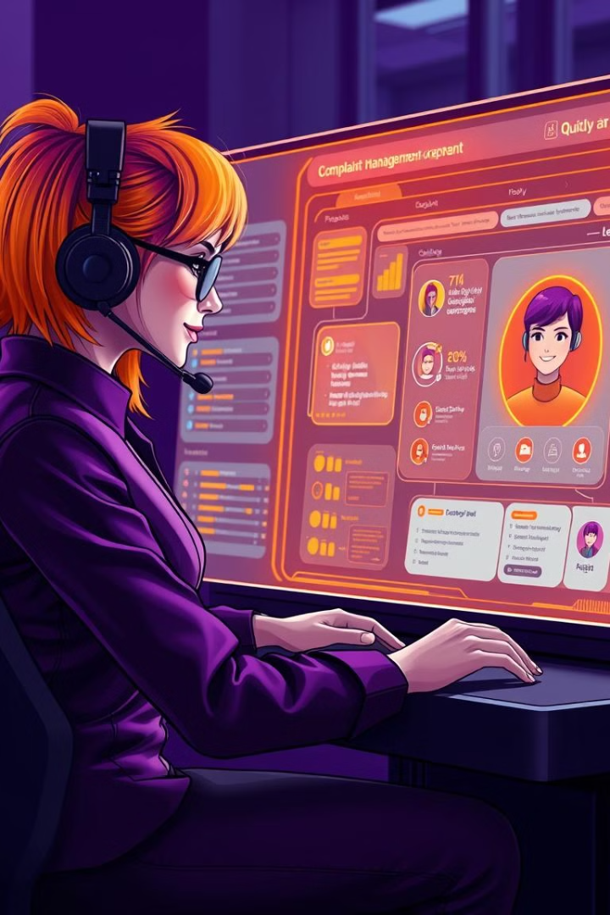
Empowering Employees to Resolve Complaints
1
Knowledge Base
Provide employees with access to a comprehensive knowledge base containing policies, procedures, and FAQs to address common complaints.
2
Escalation Process
Establish clear escalation procedures for complex or unresolved complaints, ensuring prompt involvement of senior personnel.
3
Performance Monitoring
Track employee performance in handling complaints, provide feedback, and offer opportunities for continuous improvement.

Slide 9

Building Customer Trust and Loyalty
1
Transparency
2
Empathy
Keep customers informed throughout the complaint resolution process, providing regular updates and acknowledging their concerns.
Demonstrate genuine concern and understanding for the customer's experience and their perspective on the issue.
3
Fair Resolution
4
Follow-Up
Offer solutions that are fair, equitable, and address the root cause of the complaint, ensuring customer satisfaction.
Reach out to customers after resolving their complaint to ensure their satisfaction and gauge their overall experience.

Slide 10
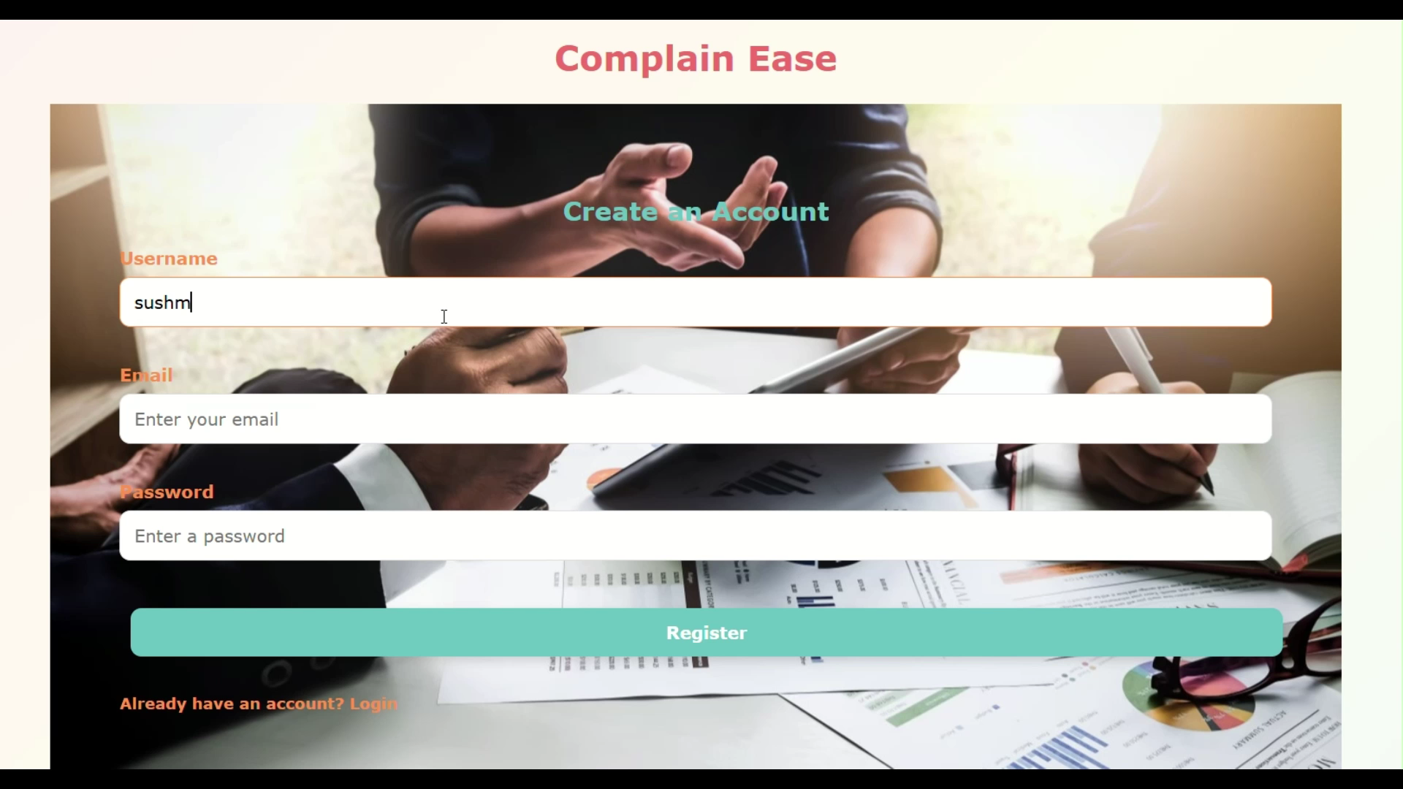

Slide 11
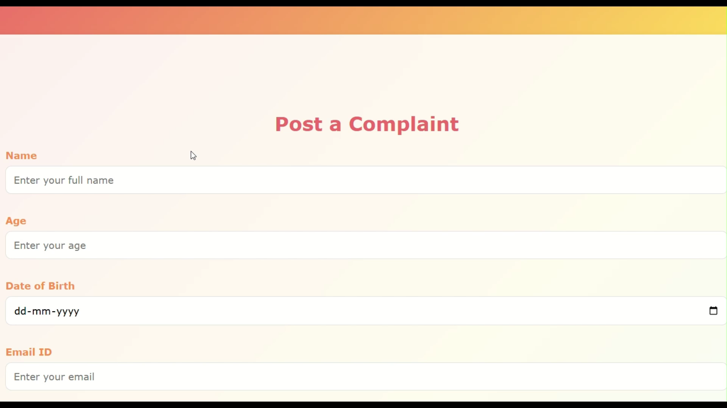

Slide 12
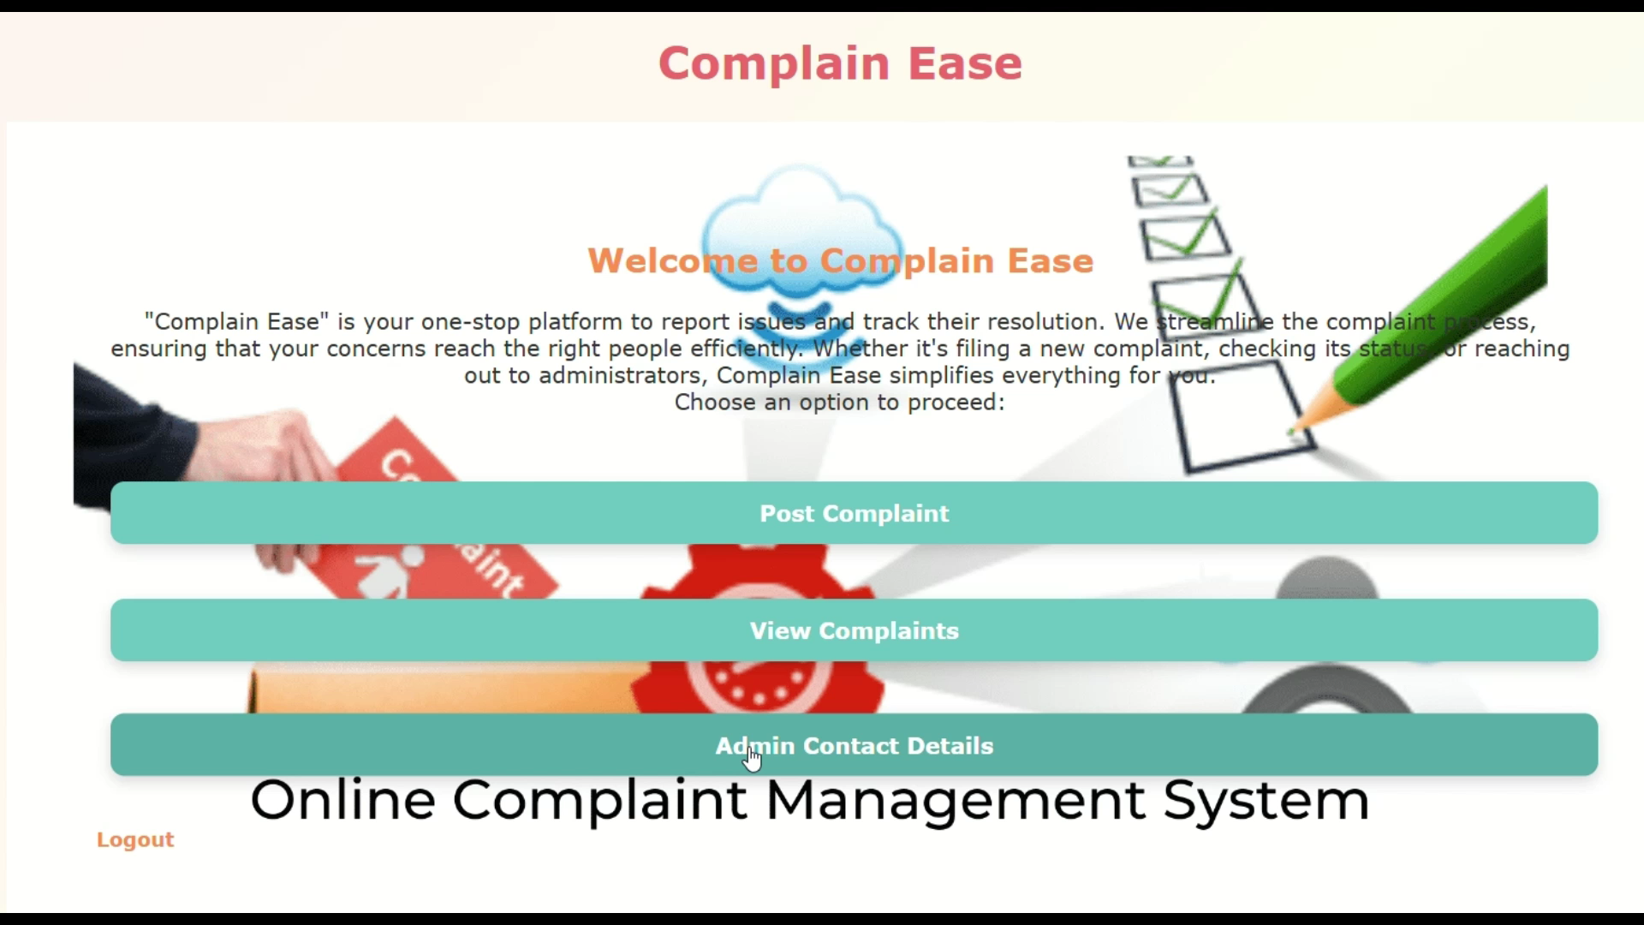

Slide 13
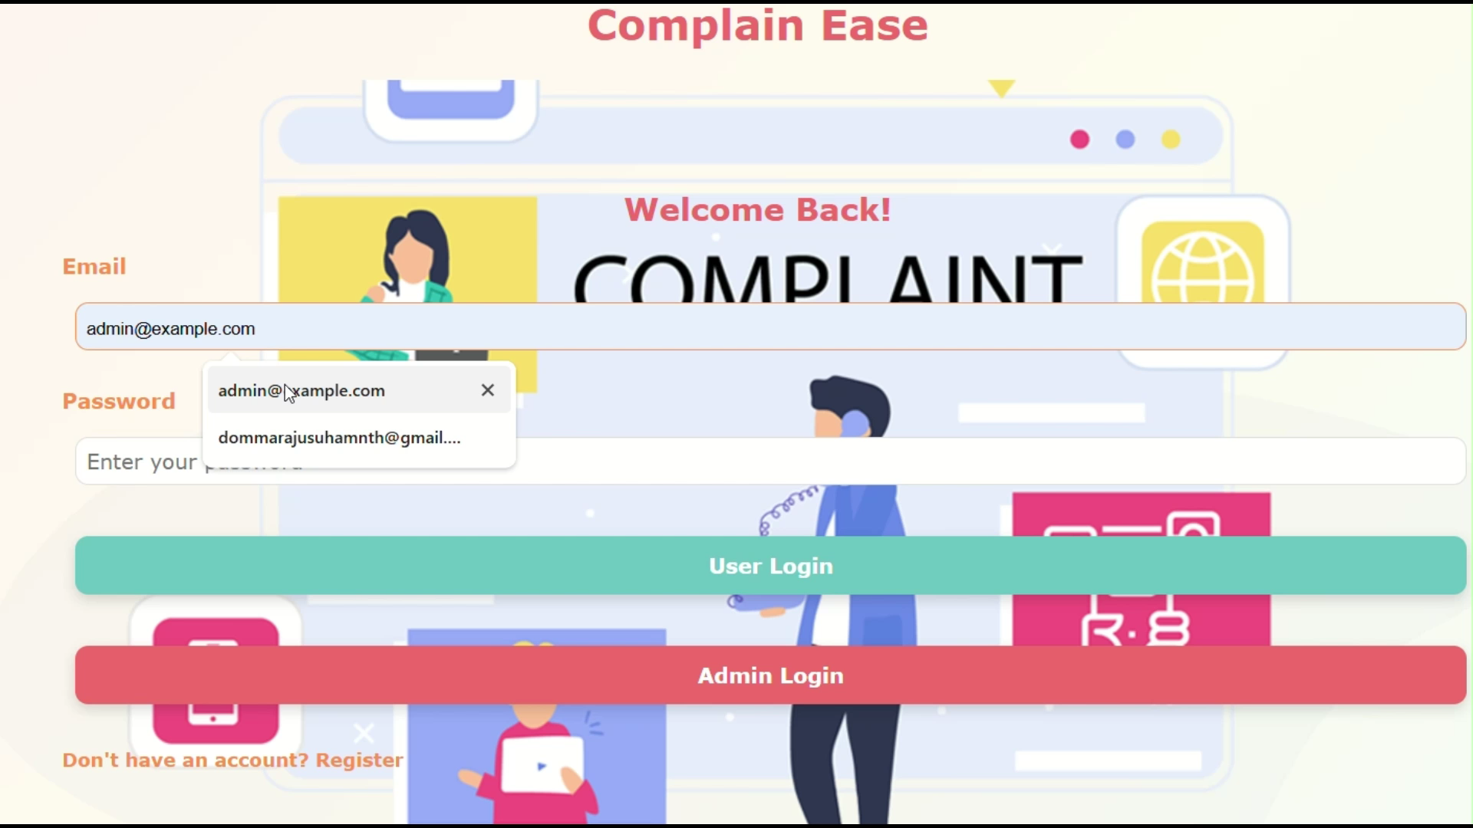

Slide 14
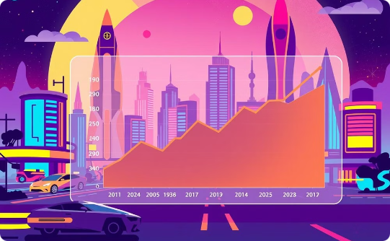
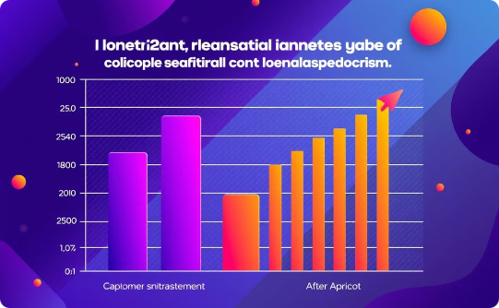
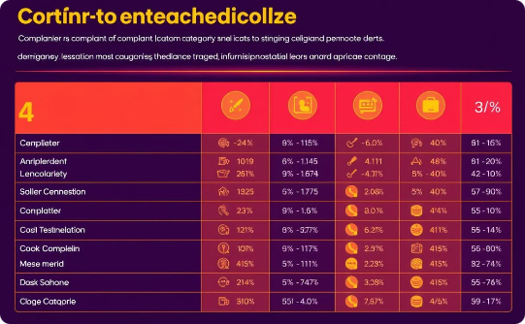
Continuous Improvement and Optimization
Complaint Resolution Time
Customer Satisfaction
Complaint Categories
Monitor and track complaint resolution times, identifying areas for improvement and aiming for faster, more efficient resolution.
Regularly measure customer satisfaction with the complaint handling process, using feedback to identify areas for enhancement.
Analyze complaint categories to identify common issues and prioritize improvements in those areas.

Slide 15


